Slide 1
Before adding signature on forms you should have an image of your signature first… then do follow the below process

Slide 2
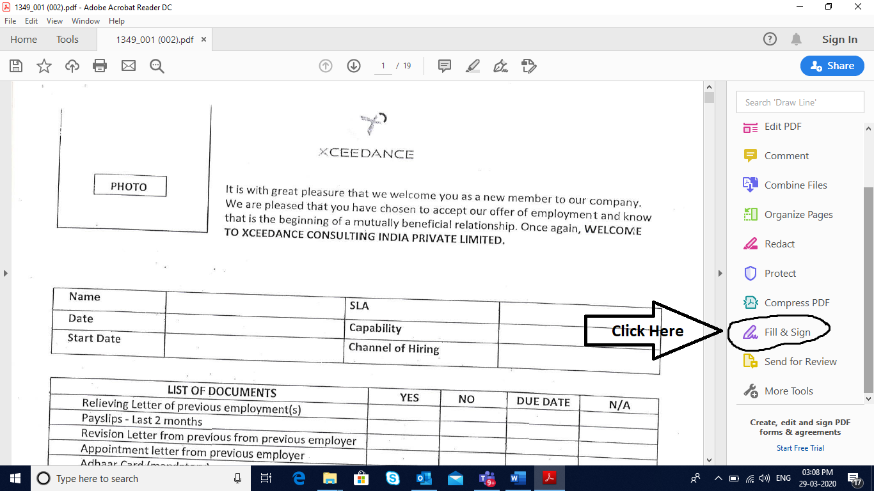

Slide 3
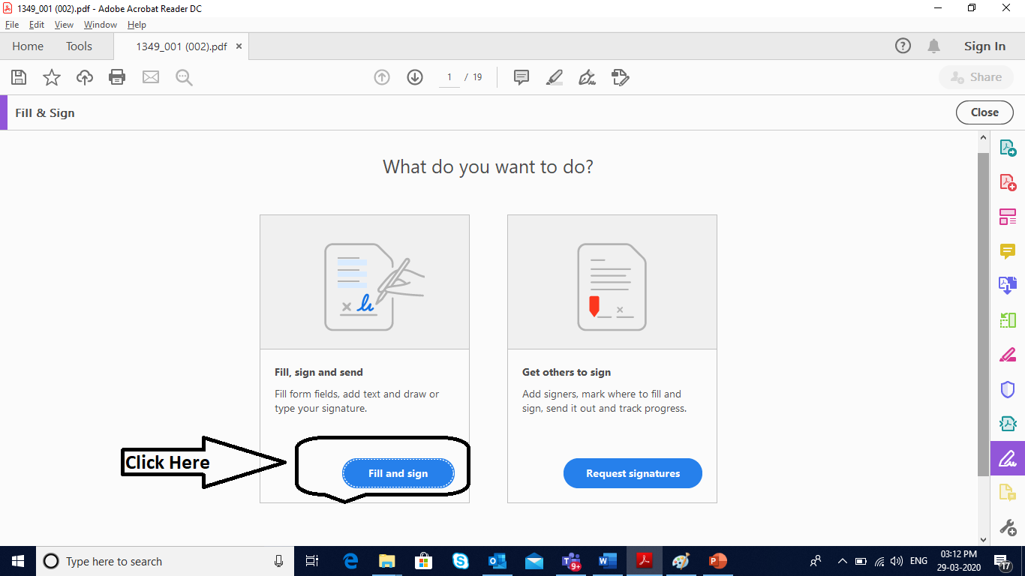

Slide 4
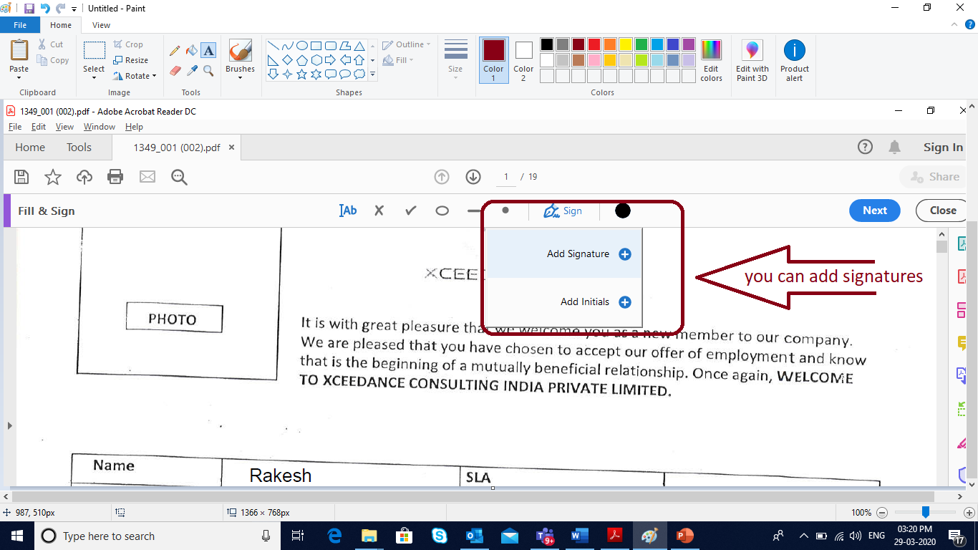

Slide 5
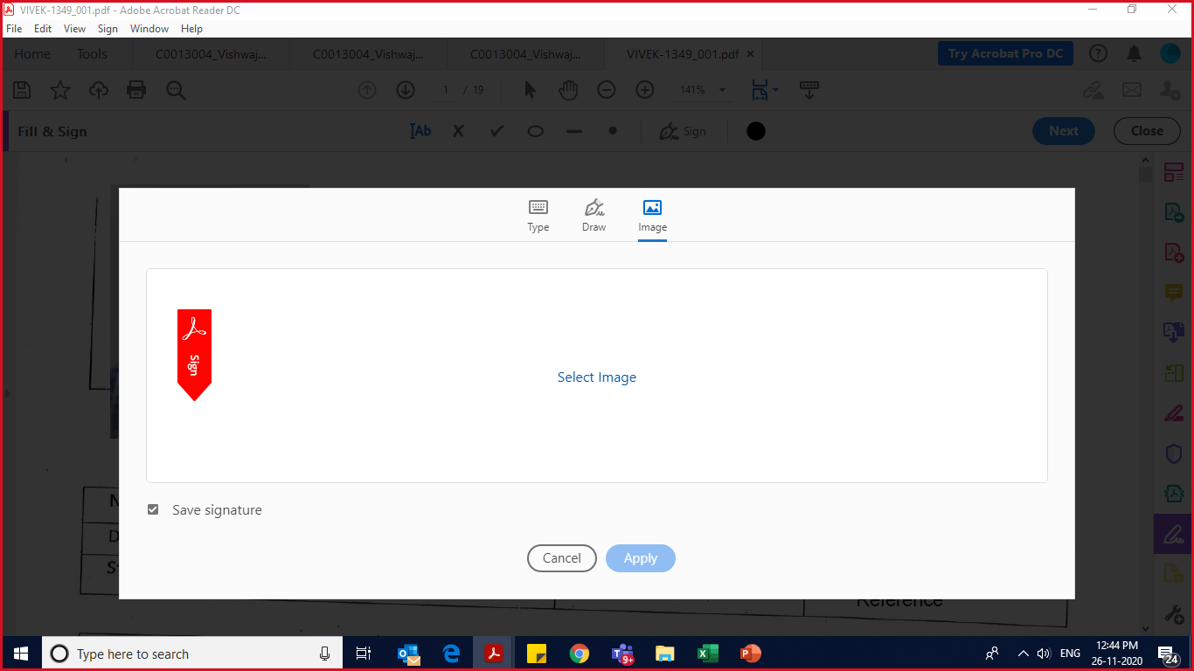
Click on Image and then you can add your signature as an image.

